Slide 1

Transgender Patient Care
Carolyn Ragsdale and Joella Jones

Slide 2

THE HOSPITAL AND THE STAFF MUST COMMIT TO MEETING THE NEEDS OF THE DIVERSE PATIENTS THEY SERVE

Slide 3
Objectives for this Session
Understanding Procedures related to gender confirming surgery.
Describe AST Core Curriculum related to gender confirming surgery.
Understand effective communication with the transgender patient.
Describe creating an inclusive environment in the operating room.
Develop and describe classroom activities related to gender confirming surgery.

Slide 4
Sex Reassignment Surgery
Sex reassignment surgery refers to procedures that help people transition to their self-identified gender. Today, many people prefer to use the terms gender affirmation or confirmation surgery.
People may have surgery so that their physical body matches their gender identity. People who choose gender affirmation surgery do so because they experience gender dysphoria. Gender dysphoria is the distress that occurs when your sex assigned at birth does not match your gender identity.
Notes:
"When the patients come in to see us, they have been totally evaluated emotionally, psychologically, physically, where they go through intense evaluation to make sure that this is what they really want. They’ve seen their surgeon multiple times. They are given hormone therapy to start the gender reassignment even before they have surgery — estrogen or testosterone. "And they are actually some of the happiest people we deal with. They come in pretty upbeat because they're finally getting something they’ve wanted, for a lot of these people, their whole life, because they’ve had gender dysphoria from as far back as they can remember

Slide 5
Gender-affirming surgery gives transgender people
a body that aligns with their gender.
Cheekbones: Many transgender women have injections to enhance the cheekbones.
Chin: Soften or more prominently define the chin’s angles.
Jaw: Shave down the jawbone or use fillers to enhance the jaw.
Nose: Reshape the nose.

Slide 6
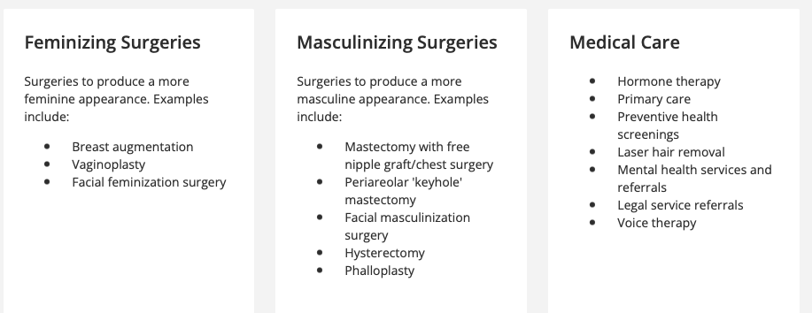

Slide 7
How common is gender affirmation surgery?
Surveys report that around 1 in 4 transgender and nonbinary people choose gender affirmation surgery.
Research has shown that transgender individuals who choose gender-affirming surgery experience long-term mental health benefits. In one study, a person’s odds of needing mental health treatment declined by 8% each year after the gender-affirming procedure.
Source: Cleveland Clinic

Slide 8
Care of the Transgender Patient
Surgical Technology Curriculum and Activities
Notes:
So how does this impact our work as a surgical technologist or as surgical technology faculty? Introduce Joella for her words and answering a few of my questions.

Slide 9
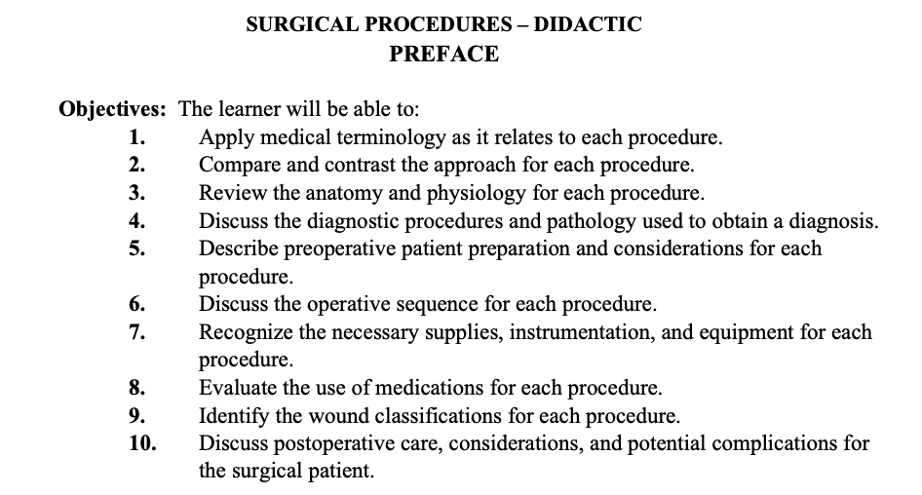
Surgical Procedures Lecture- Included in Core Curriculum
Source AST Core Curriculum 7th edition
Notes:
Procedures specific to gender confirming surgery are already procedures in the Core Curriculum.
Presentation of the procedures is the same

Slide 10
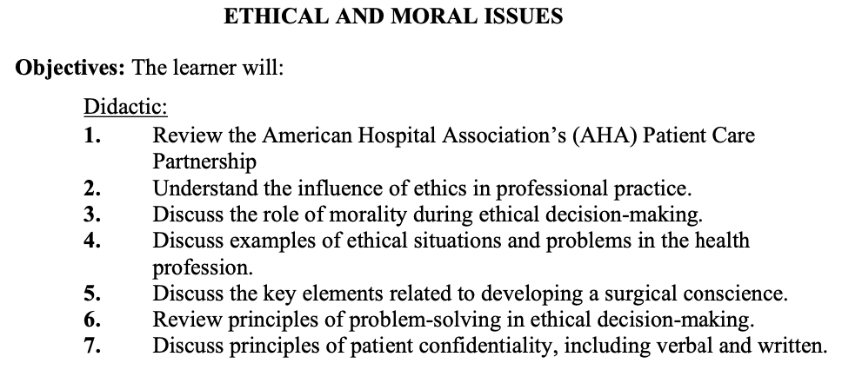
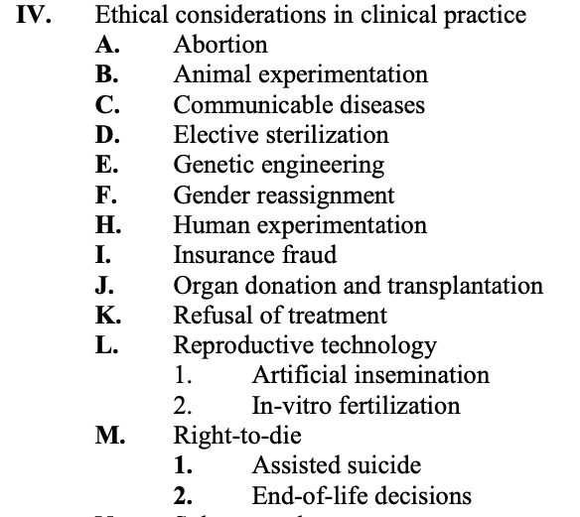
Ethical and Moral Issues- Included in Core Curriculum
Source AST Core Curriculum 7th edition
Notes:
Presenting Ethics, Moral Issues, Patient Privacy etc., are also all in the Core Curriculum and would be covered.

Slide 11
Perioperative Communication
Review Effective Communication and HIPAA required by the 7th edition Core Curriculum
  Review with students their role in communication and privacy
Review Aeger Primo.
  reflects total commitment to patient safety and advocacy
It is important that all people have access to the same levels of healthcare. Healthcare professionals need to be aware of any implicit biases they may have and work to remove them.
Notes:
The role of the surgical technologist with therapeutic communication is minimal in most clinical settings. However, reviewing effective communication basics along with learning more about effective communication with a transgender patient is vital to ensure optimal surgical care. A very basic question to the patient for the entire team is How would you like us to address you. This is not a question for trans patients only.
Patient rights are a subset of human rights

Slide 12
Comfort
If patients feel unsafe or defensive, they may not share useful information, such as:
  Transgender status
  Medications (for instance, hormones)
  Symptoms, even important ones
Stress slows wound healing and inhibits immune function
Stress also can make transpeople less willing to seek medical help

Slide 13
Basic Comfort Considerations
Avoid generalizations and assumptions
Ask questions if you are unsure about something
Make every attempt to use correct pronouns: the ones they use for themselves
  If you do not know which pronoun to use, ask which they prefer.
  If you do use an incorrect pronoun, apologize, but do not make a big deal of it.

Slide 14
Cultural Humility
Cultural humility is defined as having traits of respect, empathy, and critical self-reflection at both intrapersonal and interpersonal levels.
The intrapersonal component involves an awareness of the limited ability to understand the worldview and culture of the patient.
Preparing future generations of healthcare workers to practice cultural humility will improve outcomes for students, clinicians, and patients.

Slide 15
Surgical Team Conflict in Participating in
Medical Procedures
Title VII of the Civil Rights Act of 1964 prohibits employers from discriminating against applicants and employees based on their religion, and requires employers to provide a reasonable accommodation of employees’ sincerely held religious beliefs.
Healthcare employers may face other unique accommodation requests, such as requests:
  to decline mandatory vaccinations;
  to refuse to perform or participate in certain medical procedures; and
  to refuse to dispense or administer certain medications.
Notes:
During lecture, talk about being proactive for accommodations or omissions from certain treatments. The ability to accommodate a request to refuse to perform or participate in certain medical procedures can sometimes depend on the size of the healthcare facility.

Slide 16

Related Activities for Students
Cultural Sensitivity
Communication
Generalizations and Stereotypes
Cultural Practices for Health and Well-being
https://socialwork.illinois.edu
Cultural Humility Workbook

Slide 17


Slide 18


